Slide 1


Smart Crawler
A Two-stage Crawler for Efficiently
Harvesting Deep-Web Interfaces
Guide Name :- A.L.Lavanya
Presented by
A.Mallikharjuna
K.Manisha
J.Vinodh kumar
B.Rajesh Kumar
313175710007
313175710070313175710055
313175710024

Slide 2

The internet is a collection of billions of web pages containing terabytes of information arranged in thousands of servers using HTML. The size of this collection itself is a challenge in retrieving necessary and relevant information.
As deep web grows at a very pace, there has been increased interest in techniques that help efficiently locate deep web interface. Due the dynamic nature of deep web, achieving wide coverage and high efficiency is challenging issue .
We propose a two-stage framework, namely “ Smart-Crawler " to present the relevant data effectively . To make an efficient crawler that is able to accurately and quickly explore the “Deep Web Databases”.

Slide 3
EXISTING SYSTEM
The existing system is a manual or semi-automated system.
Previous work has proposed two types of crawlers. Generic crawlers fetch all searchable forms and cannot focus on a specific topic.
And Focused crawlers can automatically search online databases on a specific topic.

Slide 4
DISADVANTAGES
Large quantity sources are displayed
Low quality forms also displayed as a output.
The crawler can be inefficiently led to pages
without targeted forms.

Slide 5
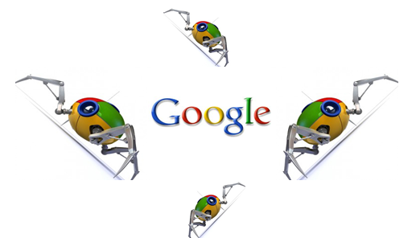

Slide 6


Slide 7
Google Market Share – 79.88%
Bing Market Share -- 9.9%
Yahoo! Market Share -- 8.34%
ASK.com Market Share -- about 1%
AOL Market share – 0.84%
DuckDuckGo – 0.41%

Slide 8
PROPOSED SYSTEM
We propose an effective deep web harvesting framework, namely Smart Crawler, for achieving both wide coverage and high efficiency for a focused crawler.
Based on the observation that deep websites usually contain a few searchable forms and most of them are within a depth of three, our crawler is divided into two stages: site locating and in-site exploring.
The site locating stage helps achieve wide coverage of sites for a focused crawler, and the in-site exploring stage can efficiently perform searches for web forms within a site.

Slide 9

ADVANTAGES
Achieving more accurate results.
Control irrelevant forms
Provide high efficiency target forms

Slide 10
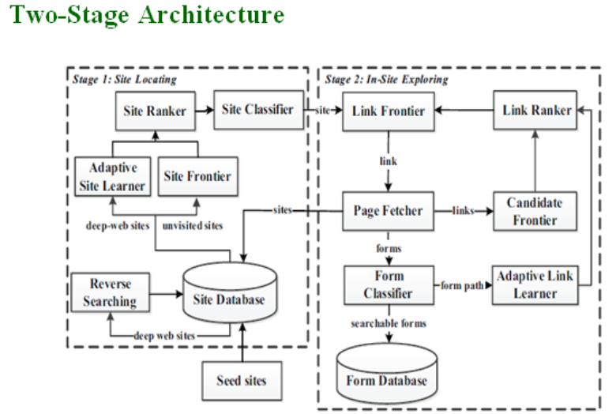

Slide 11
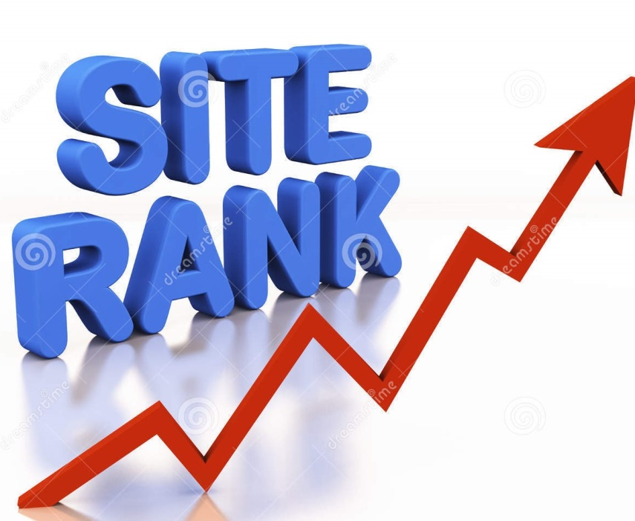

Slide 12
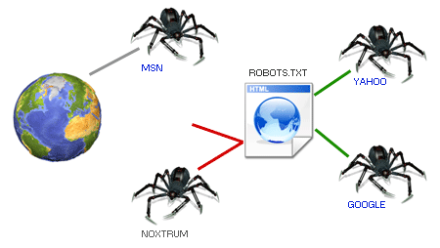

Slide 13


Slide 14
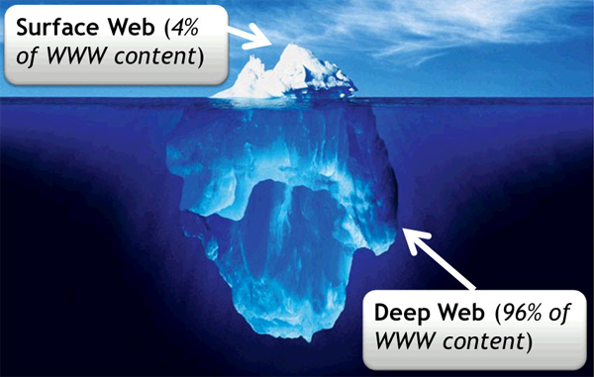
DEEP WEB

Slide 15
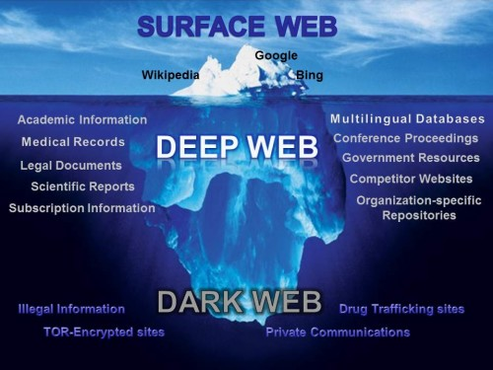

Slide 16
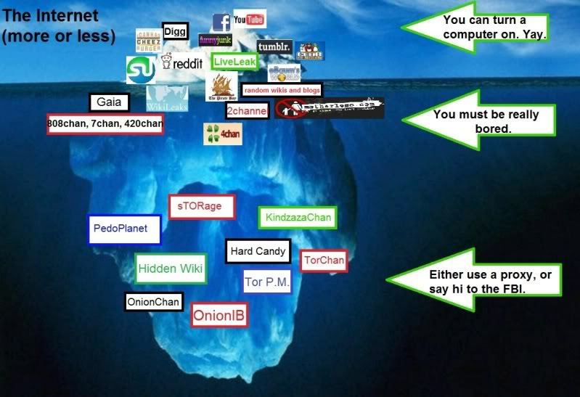

Slide 17
Algorithms
Reverse searching for more sites
Incremental site prioritizing

Slide 18
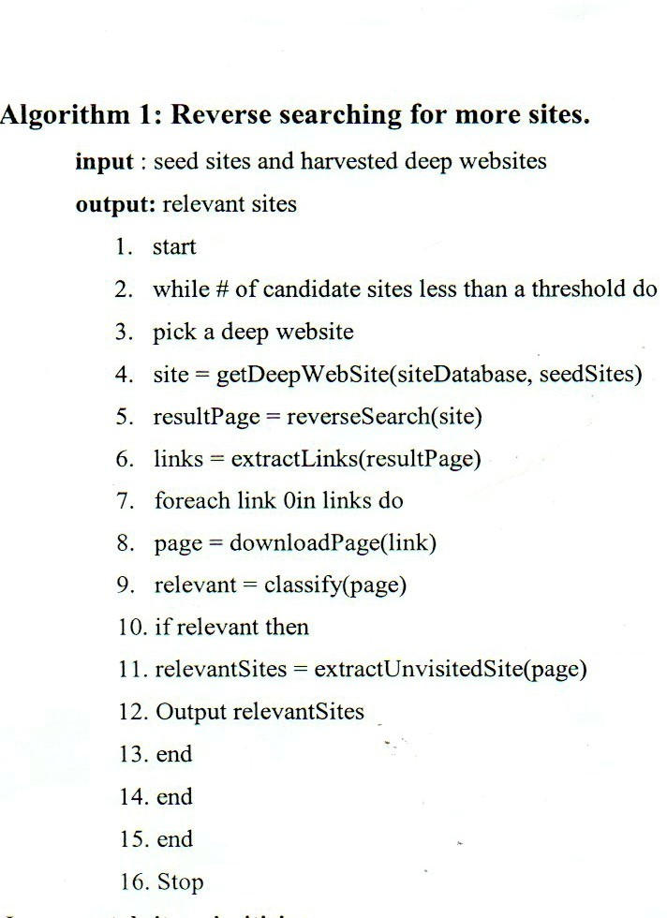

Slide 19
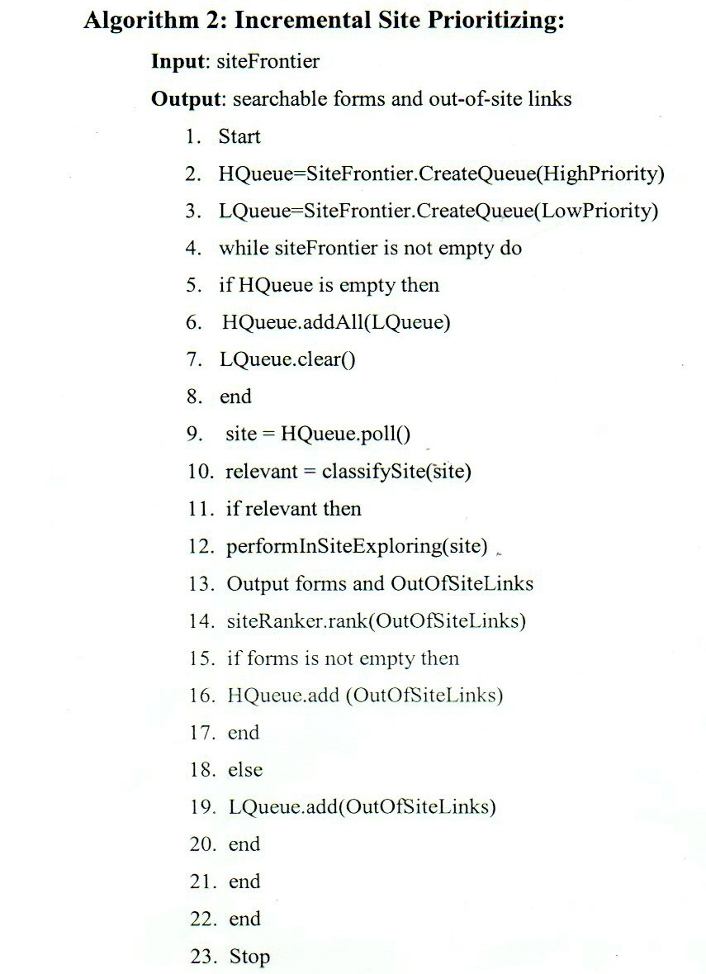

Slide 20
UML DIAGRAMS
Use Case Diagram
Class Diagram
Activity Diagram

Slide 21
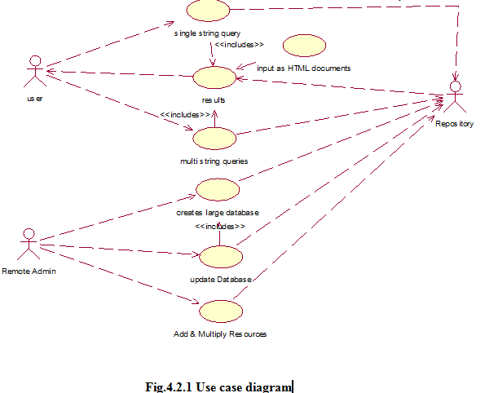

Slide 22
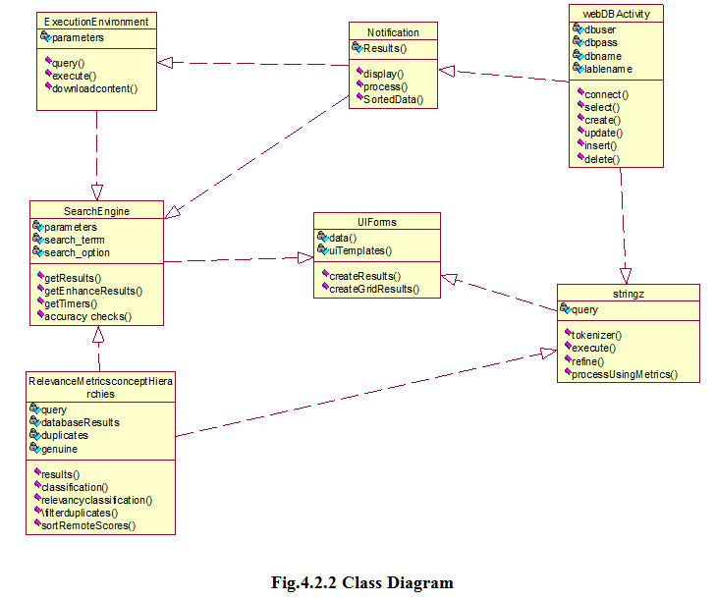

Slide 23
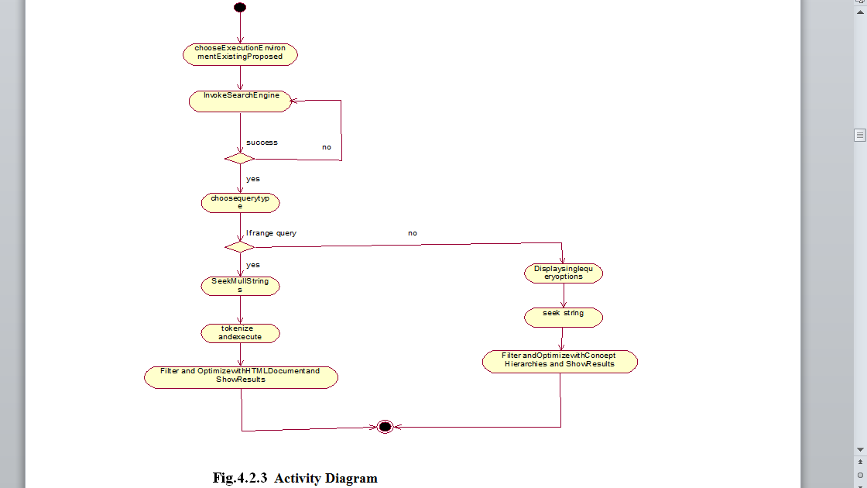

Slide 24
SOFTWARE REQUIREMENTS
Operating System - Windows
Technology - Java and J2EE
Web Technologies - Html, JavaScript, CSS
IDE - My Eclipse 8.6
Database - My SQL
Server - XAMPP1.8.0
Java Version - J2SDK 1.5

Slide 25
HARDWARE REQUIREMENTS
Processor - Intel i3
Hard Disk - 80GB
RAM - 2GB
Hard Disk - 20GB
Mouse - Two or Three Button
Monitor - SVGA

Slide 26
OUTPUT-SCREENS
Run configuration
Add arguments
Enter keyword
Crawl and Display results
Store results in log file

Slide 27
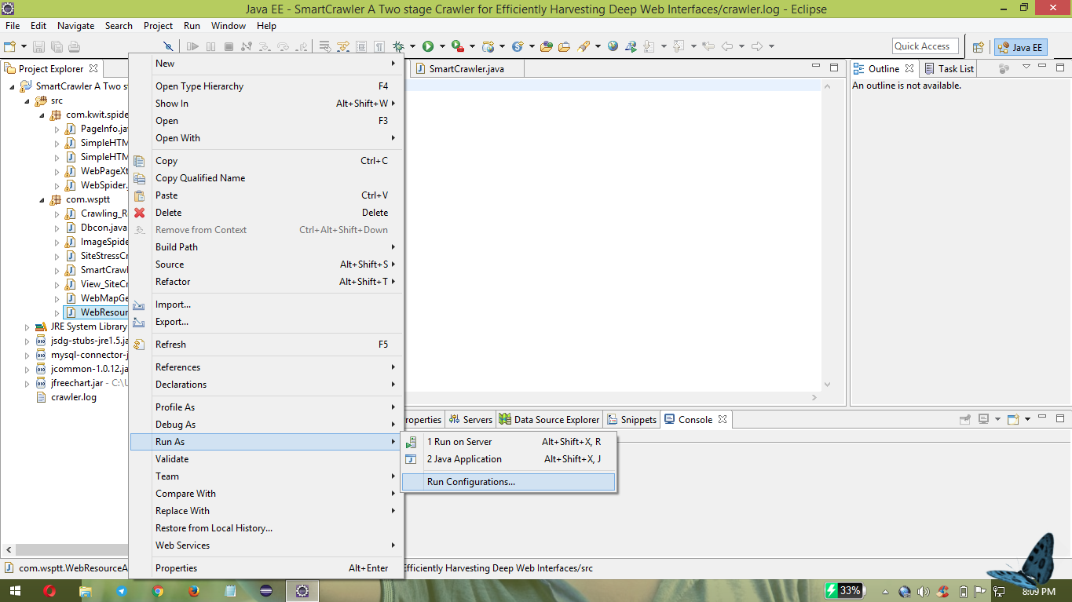

Slide 28
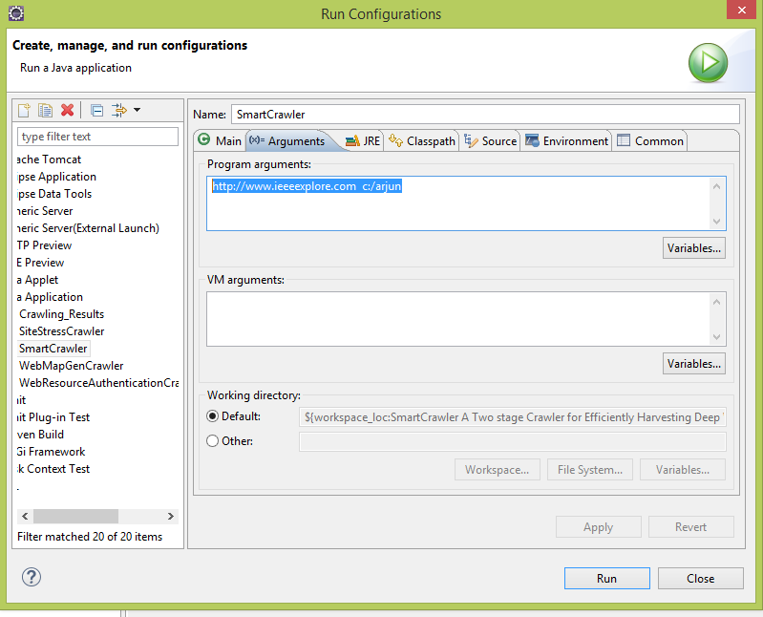

Slide 29
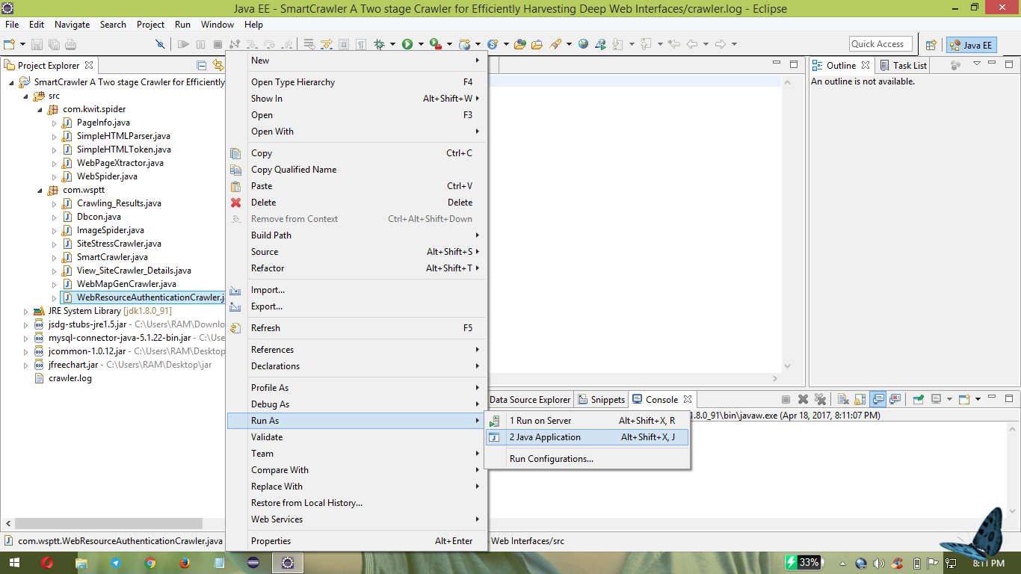

Slide 30
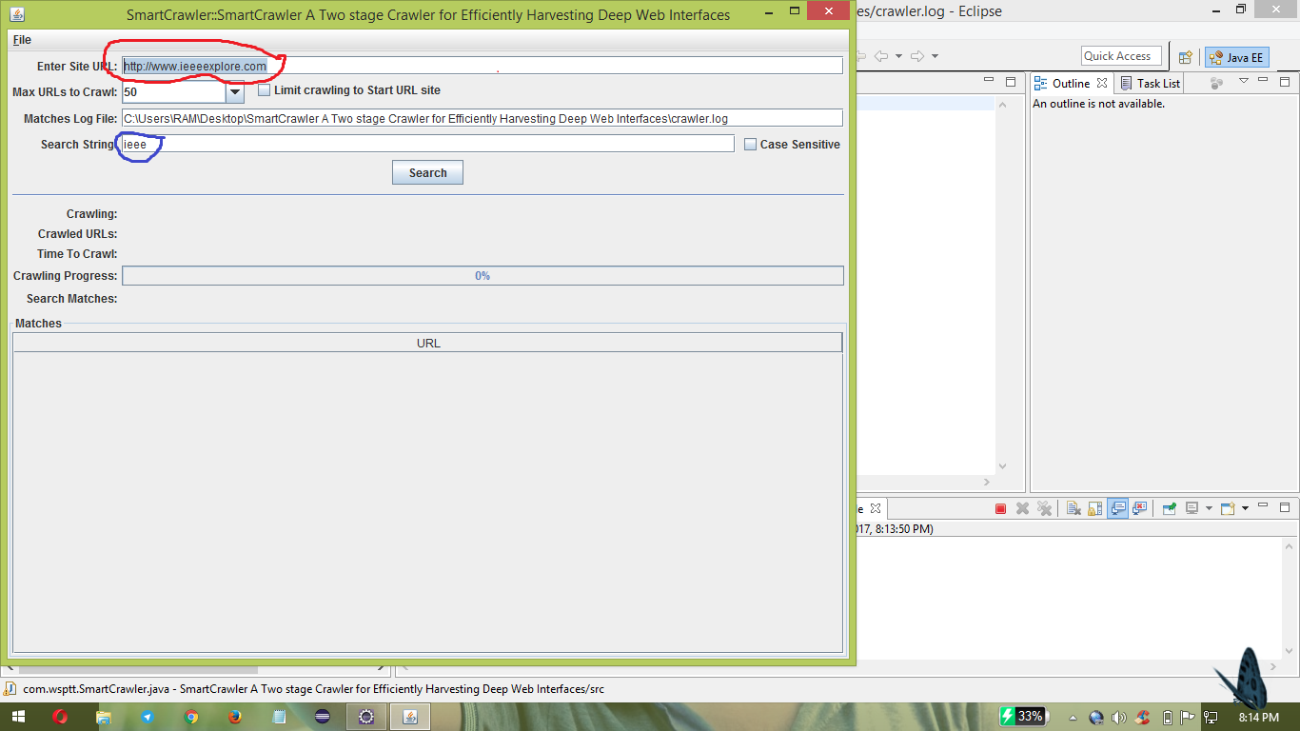

Slide 31
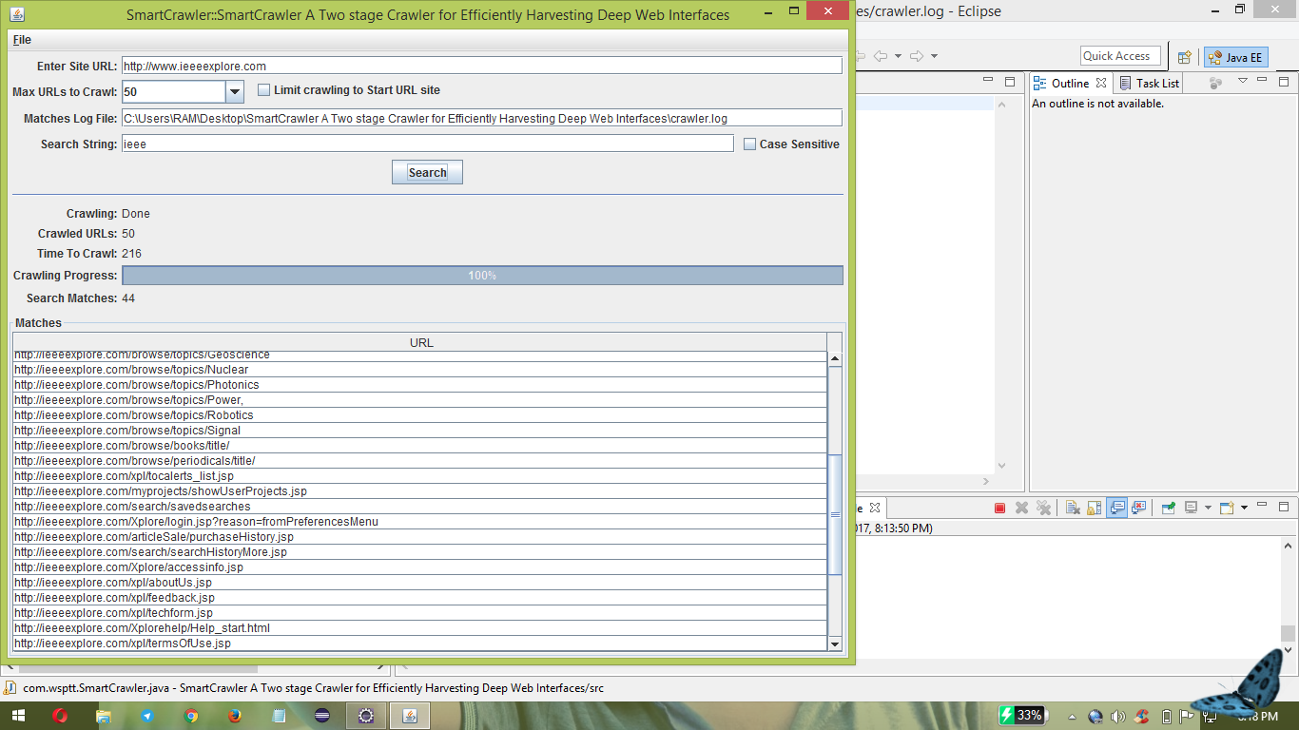

Slide 32
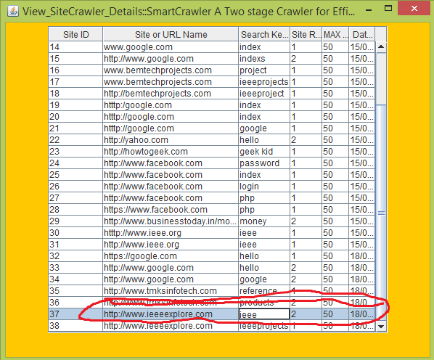

Slide 33
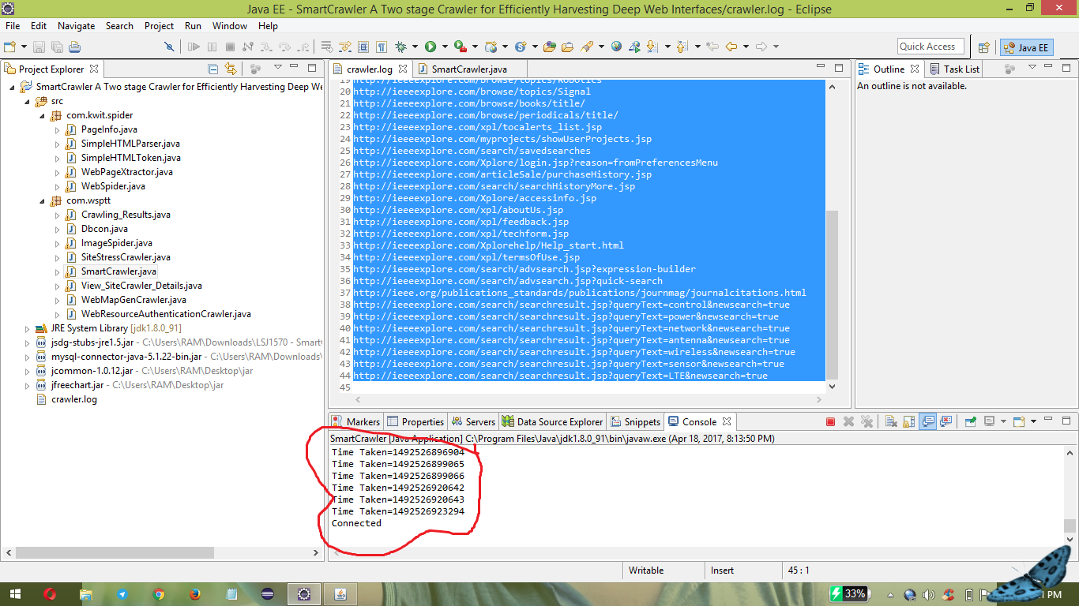

Slide 34
CONCULSION
We Shown that our approach achieves both wide range coverage for deep web, which achieves highest harvest rates than other crawlers.
In future we plan to combine pre-query and post-query approaches for classifying deep-web forms to future improve the accuracy of the form classifier.

Slide 35

ANY QUERIES ???

Slide 36
Thank You !!!

